Slide 1
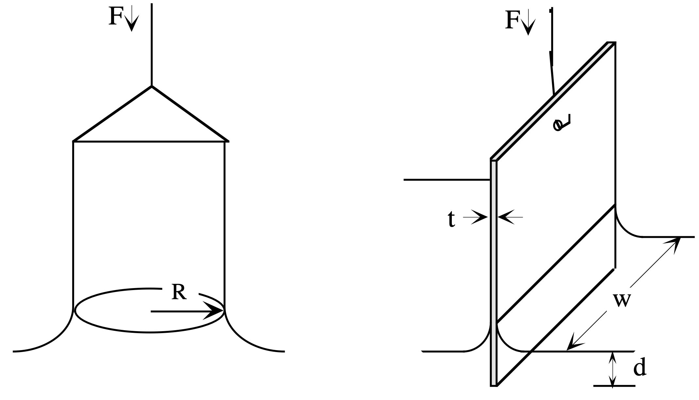
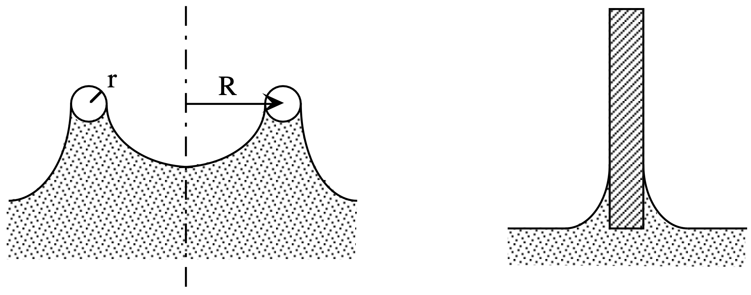
du Noüy ring
Wilhelmy slide
Overall view
Side view

